Slide 1
iTechArt

Slide 2
iTechArt is one of the top 5 large companies of the Hi-Tech Park and works with international projects in the field of software development and testing.

Slide 3
Our team consists of 3500 highly qualified specialists in 23 offices around the world.
Our offices:
Brest, Vitebsk, Gomel, Grodno, Minsk, Mogilev, Polotsk (Belarus);
New York, San Francisco, Iselin, Marietta (USA);
London (UK);
Vienna (Austria);
Warsaw, Lodz, Wroclaw (Poland);
Kyiv, Lvov (Ukraine);
Tashkent (Uzbekistan).

Slide 4
Technological directions:
.NET;
Go;
Java;
Front-end;
PHP;
Mobile (iOS, Android);
Ruby;
Elixir;
Node.js;
Python;
Sales force;
SharePoint;• QA.

Slide 5
Development directions:
financial and insurance sphere;
retail;
healthcare;
education;
security systems;
telecommunications industry.

Slide 6
company offer:
well-equipped spacious workplaces in the A-class business center;
attractive package of benefits;
the use of the latest technologies, we have all the most trendy and innovative;
a large number of various projects;
an environment of smart and talented people with deep technical expertise. Remarkable People really work for us.

Slide 7
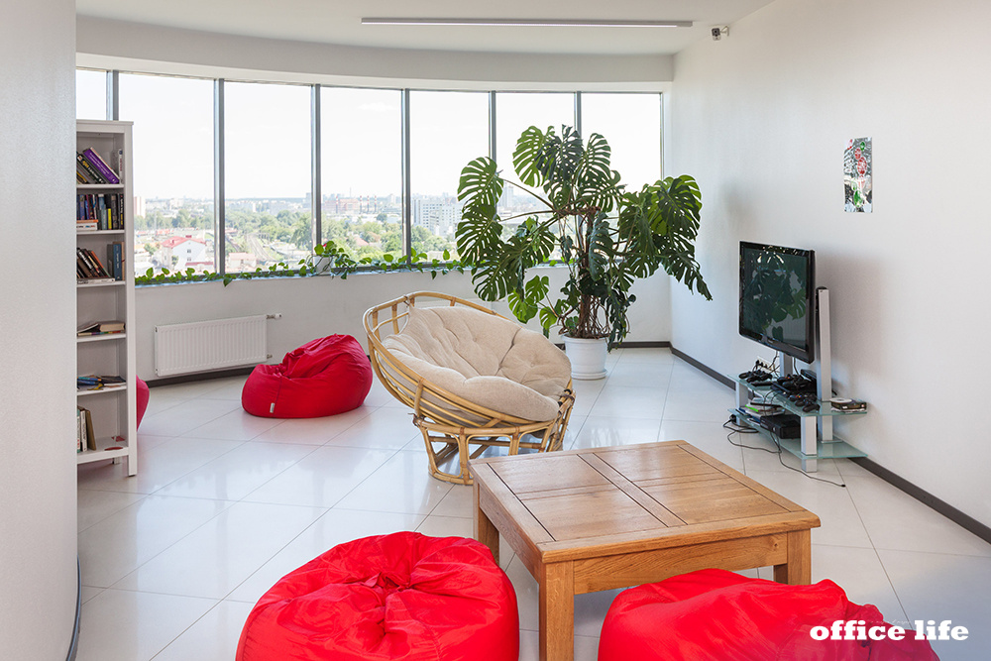
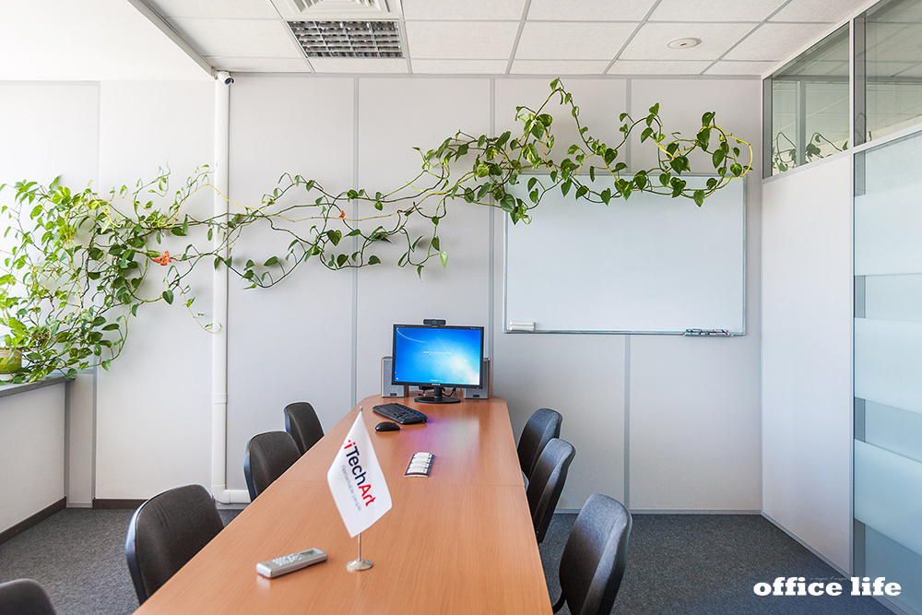
And although for iTechArt the first floor starts on the seventh floor, our tour starts in the spacious hall of the Title Business Center. There is a cafe where company employees can drink coffee, have a snack and take a pleasant break from work.

Slide 8
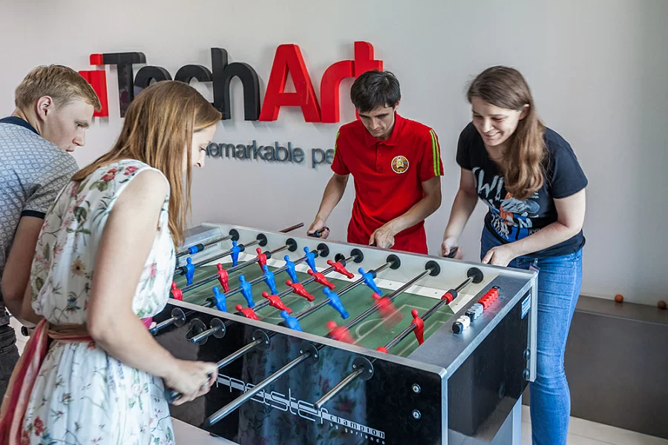
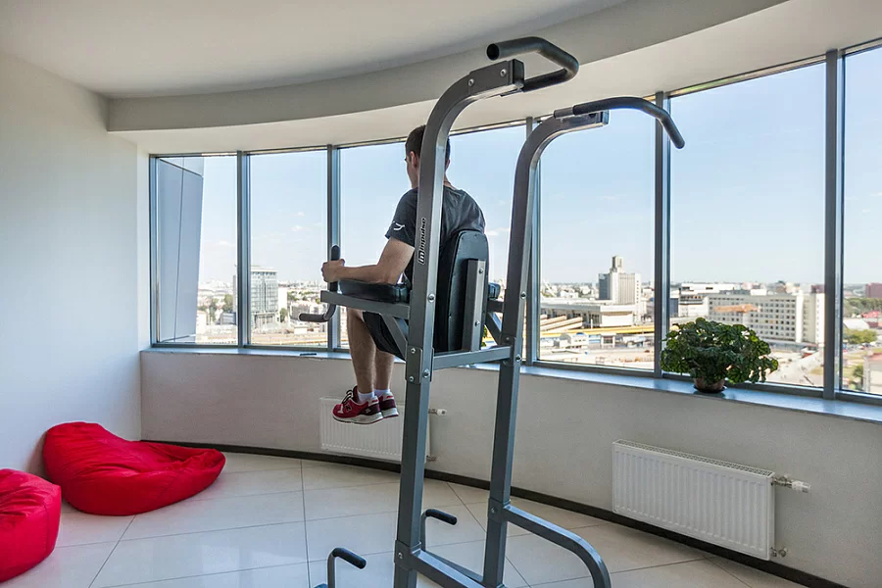
The company supports a healthy lifestyle: we have corporate training in football, basketball, badminton, as well as swimming and table tennis. For those who like to ride a bike, there is parking in the underground parking.

Slide 9
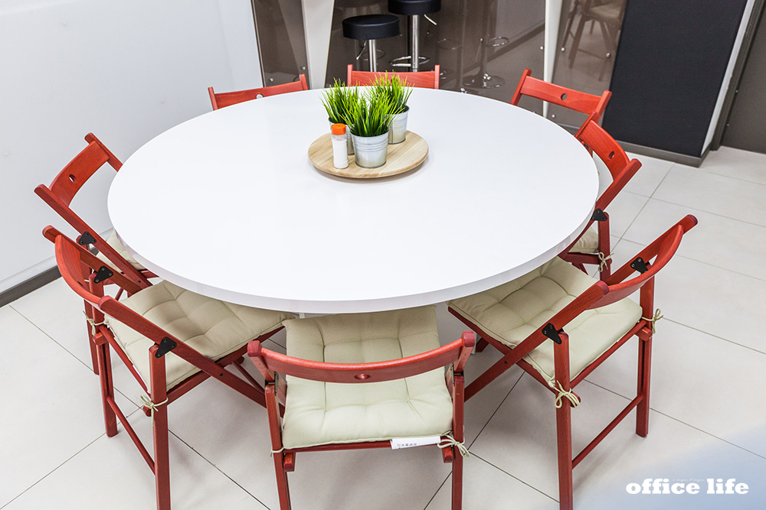
Meeting rooms, as well as the kitchen, are located on each of the floors. Seeing them free is a rare opportunity. Here employees make calls to clients, hold working meetings and organize educational lectures and meetups.

Slide 10
In 2019-2020 academic year Brest Technical University is expanding its circle of partners, and its students have the opportunity to practice one of the most sought-after professions in the global labor market!

